Slide 1
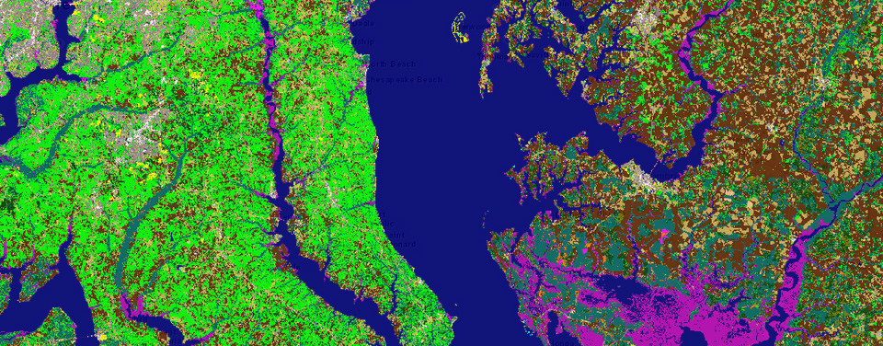

MACHINE LEARNING FOR LAND USE AND LAND COVER: A Case Study: Baton Rouge
Presentation
By
Desmond Kangah
Ms. Civil Engineering
Supervisor: Dr Mayank Tyagi
1

Slide 2
PRESENTATION OUTLINE
Introduction
Background Studies
Data and Data Analysis
Methods Used
Results and Discussion
Conclusions and Recommendations
2

Slide 3
INTRODUCTION
Land Use Land Cover (LULC) classification is essential for managing resources and monitoring environmental changes, particularly in rapidly urbanizing areas like Baton Rouge.
Traditional methods like photo-interpretation, maximum likelihood, and minimum-distance-to-mean are labour-intensive and prone to inaccuracies due to human error for classification.
Integrating remote sensing, GIS, and machine learning improves the accuracy and efficiency of LULC classification, enabling faster and more accurate analysis over large areas.
Accurate LULC classification is essential for urban planning, natural resource management, and environmental monitoring. In Baton Rouge, it aids in managing urbanization pressures, balancing infrastructure development with environmental sustainability.
3

Slide 4
CONT’ INTRODUCTION
These technologies allow for fast processing of satellite imagery, offering up-to-date insights over large areas.
The primary objective is to compare the performance of three supervised classification models, Random Forest (RF), Support Vector Machine (SVM), and Multi-Layer Perceptron (MLP) for accurate LULC classification with sentinel 2 satellite image and remote sensing indices such as normalised difference water index (NDWI), normalised difference built-up index (NDBI) and Normalised difference vegetation index.
4

Slide 5
BACKGROUND STUDIES
Sentinel-2, part of the European Space Agency's Copernicus program, is a multispectral imaging mission designed for environmental monitoring and resource management. It offers high-resolution optical imagery across 13 spectral bands, enabling precise LULC classification.
Coastal/Aerosol (B1) and Blue (B2) bands are ideal for water body monitoring and atmospheric corrections, while the Green (B3) and Red (B4) bands excel in vegetation mapping and soil differentiation.
The Red Edge bands (B5, B6, B7) are tailored for analysing plant stress and chlorophyll content, making them invaluable for agricultural monitoring.
The Near Infrared (NIR, B8) and Narrow NIR (B8A) bands are critical for assessing vegetation vigor and distinguishing land-water boundaries. Shortwave Infrared (SWIR, B11 and B12) bands are essential for evaluating soil types, vegetation water content, and detecting built-up areas.
5

Slide 6
CONT’ BACKGROUND STUDIES
Water bodies are efficiently classified using Coastal (B1), Blue (B2), and SWIR (B11, B12) bands. These bands highlight water’s unique reflectance properties, with indices like the Normalized Difference Water Index (NDWI) providing precise delineation.
Artificial surfaces, including buildings, are identified through their high reflectance in Red (B4), NIR (B8), and SWIR (B11, B12) bands. The Normalized Difference Built-up Index (NDBI) is a key tool for detecting urban areas.
Bareland is characterized by strong reflectance in SWIR and NIR bands, contrasting with low vegetation index values like the Normalized Difference Vegetation Index (NDVI). This distinction aids in accurate soil and terrain mapping.
6

Slide 7
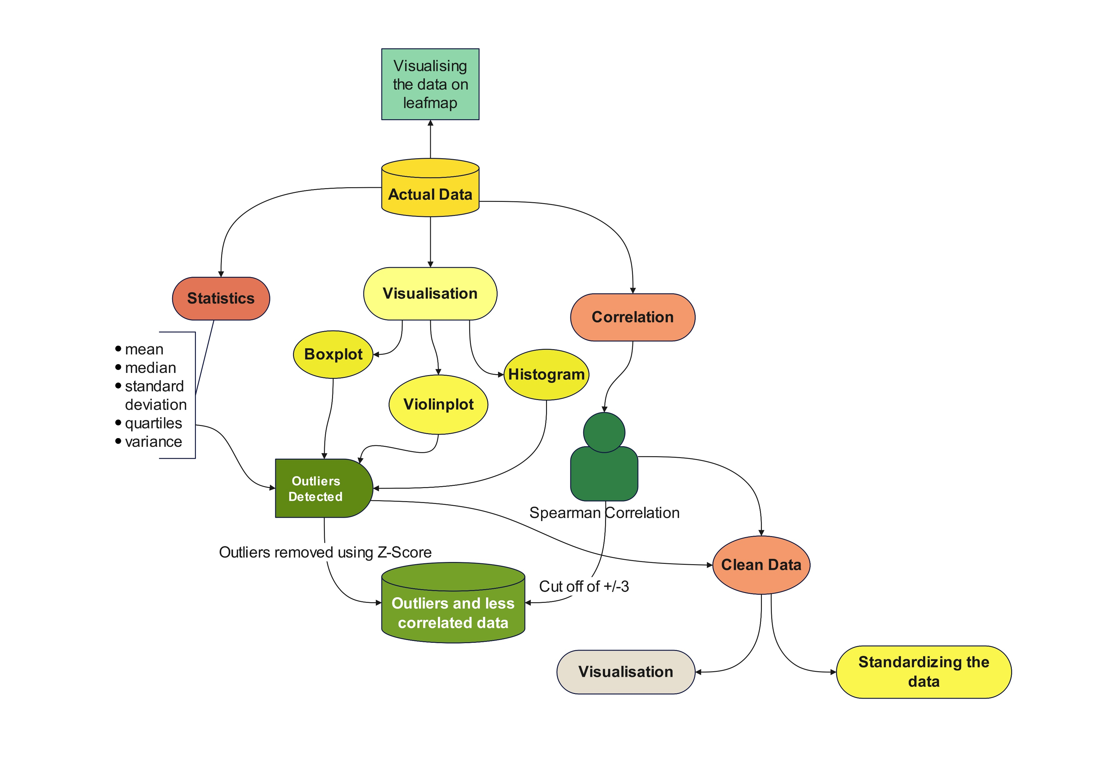
DATA AND DATA ANALYSIS
Data
Sentinel 2 image of part of East Baton Rouge
Band values and indices in geojson formation with
their geometric features (position coordinates)
Fig. 1. Flowchart of Data Analysis
7

Slide 8
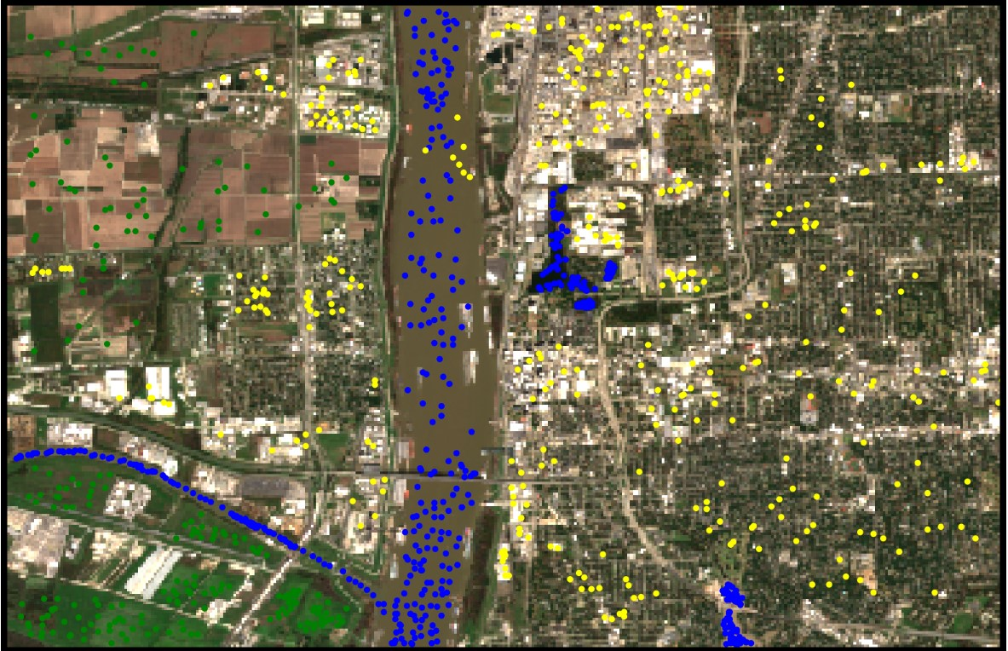
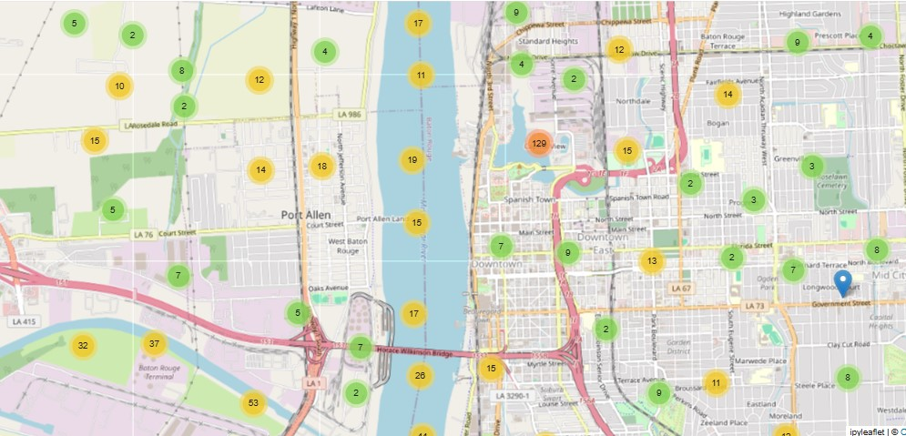
DATA AND DATA ANALYSIS
Fig. 2. samples on leafmap visualisation
Fig. 3. 3 samples on sentinel 2 image
8
Original data with Outliers

Slide 9
DATA AND DATA ANALYSIS
Table. 1. Data statistics
index | B1 | B2 | B3 | B4 | B5 | B6 | B7 | B8 | B8A | B9 | B11 | B12 | NDVI | NDWI | NDBI | Latitude | Longitude
count | 1125 | 1125 | 1125 | 1125 | 1125 | 1125 | 1125 | 1125 | 1125 | 1125 | 1125 | 1125 | 1125 | 1125 | 1125 | 1125 | 1125
mean | 0.065237 | 0.07169 | 0.097414 | 0.098782 | 0.124888 | 0.15502 | 0.170333 | 0.174244 | 0.180561 | 0.186453 | 0.163604 | 0.121237 | 0.133857 | 0.1005 | -0.1005 | 30.44978 | -91.1959
std | 0.048708 | 0.06771 | 0.070701 | 0.084117 | 0.086324 | 0.110835 | 0.122431 | 0.131205 | 0.134636 | 0.121929 | 0.135832 | 0.114738 | 0.387665 | 0.235962 | 0.235962 | 0.0198 | 0.023557
min | 0.0154 | 0.0123 | 0.0195 | 0.0158 | 0.022 | 0.0157 | 0.0155 | 0.0098 | 0.0109 | 0.0081 | 0.0071 | 0.0068 | -0.50549 | -0.50835 | -0.86085 | 30.42257 | -91.2397
25% | 0.0354 | 0.0377 | 0.0557 | 0.0411 | 0.0483 | 0.0309 | 0.0331 | 0.0307 | 0.0247 | 0.0546 | 0.0186 | 0.0148 | -0.28923 | -0.07943 | -0.23625 | 30.4311 | -91.214
50% | 0.0451 | 0.0472 | 0.0788 | 0.0745 | 0.1142 | 0.1774 | 0.1928 | 0.1966 | 0.2069 | 0.2113 | 0.1779 | 0.1069 | 0.116856 | 0.104089 | -0.10409 | 30.44808 | -91.1967
75% | 0.0785 | 0.0846 | 0.1096 | 0.1308 | 0.161 | 0.2239 | 0.2493 | 0.262 | 0.2747 | 0.2704 | 0.2635 | 0.1931 | 0.424648 | 0.236246 | 0.079427 | 30.46533 | -91.1796
max | 0.4281 | 0.6 | 0.6504 | 0.708 | 0.7476 | 0.7212 | 0.7202 | 0.732 | 0.7215 | 0.6731 | 0.7877 | 0.8529 | 0.887646 | 0.860854 | 0.508353 | 30.48716 | -91.1399
variance | 0.002372 | 0.00458 | 0.004999 | 0.007076 | 0.007452 | 0.012284 | 0.014989 | 0.017215 | 0.018127 | 0.014867 | 0.01845 | 0.013165 | 0.150284 | 0.055678 | 0.055678 | 0.000392 | 0.000555
median | 0.0451 | 0.0472 | 0.0788 | 0.0745 | 0.1142 | 0.1774 | 0.1928 | 0.1966 | 0.2069 | 0.2113 | 0.1779 | 0.1069 | 0.116856 | 0.104089 | -0.10409 | 30.44808 | -91.1967
9
Original data with Outliers

Slide 10
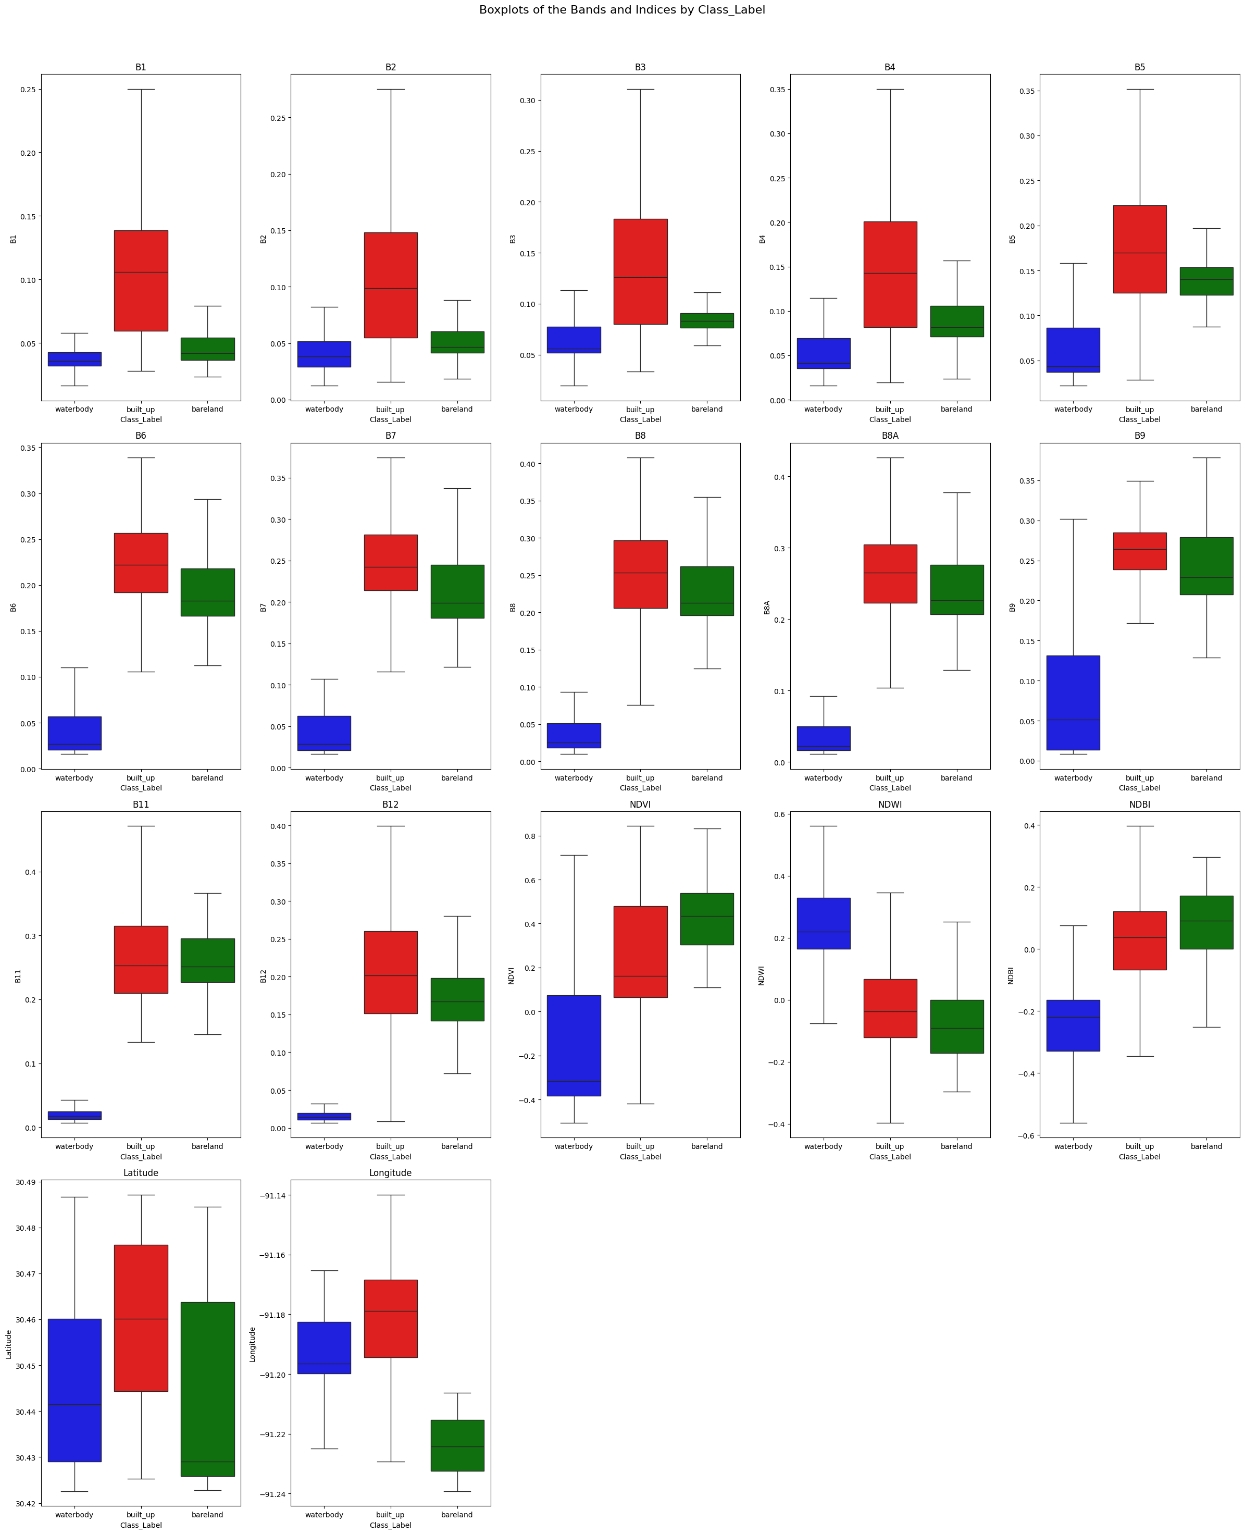
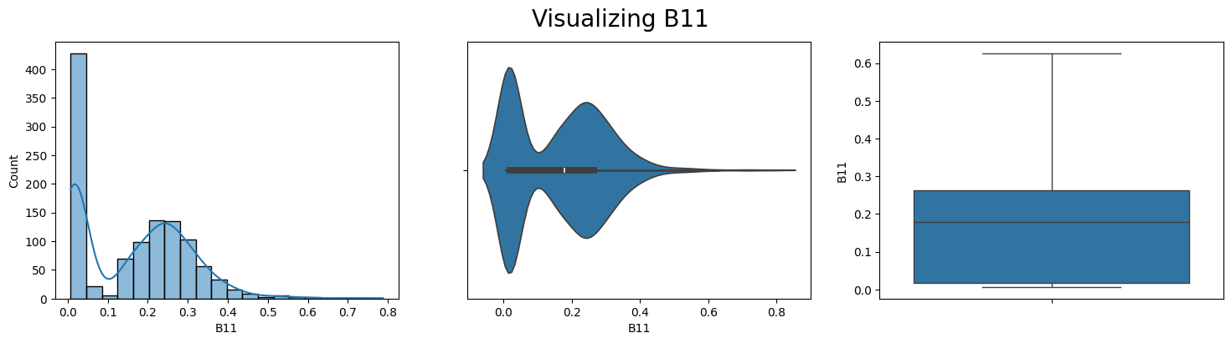
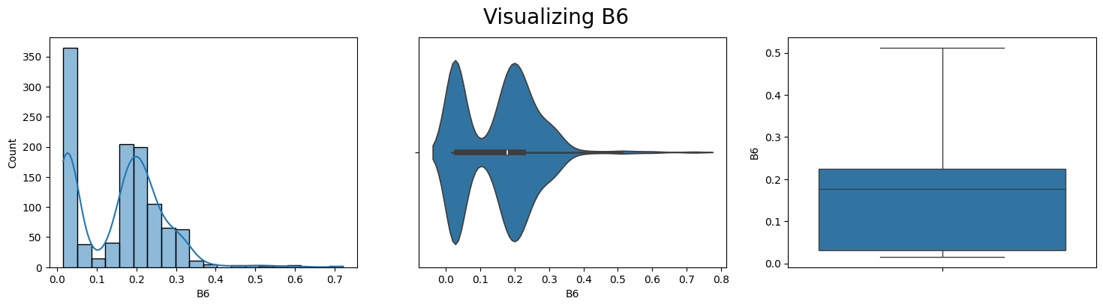
DATA AND DATA ANALYSIS
Fig. 4. Data visualization with Boxplot, histogram and violin
10
Original data with Outliers Visualizations

Slide 11
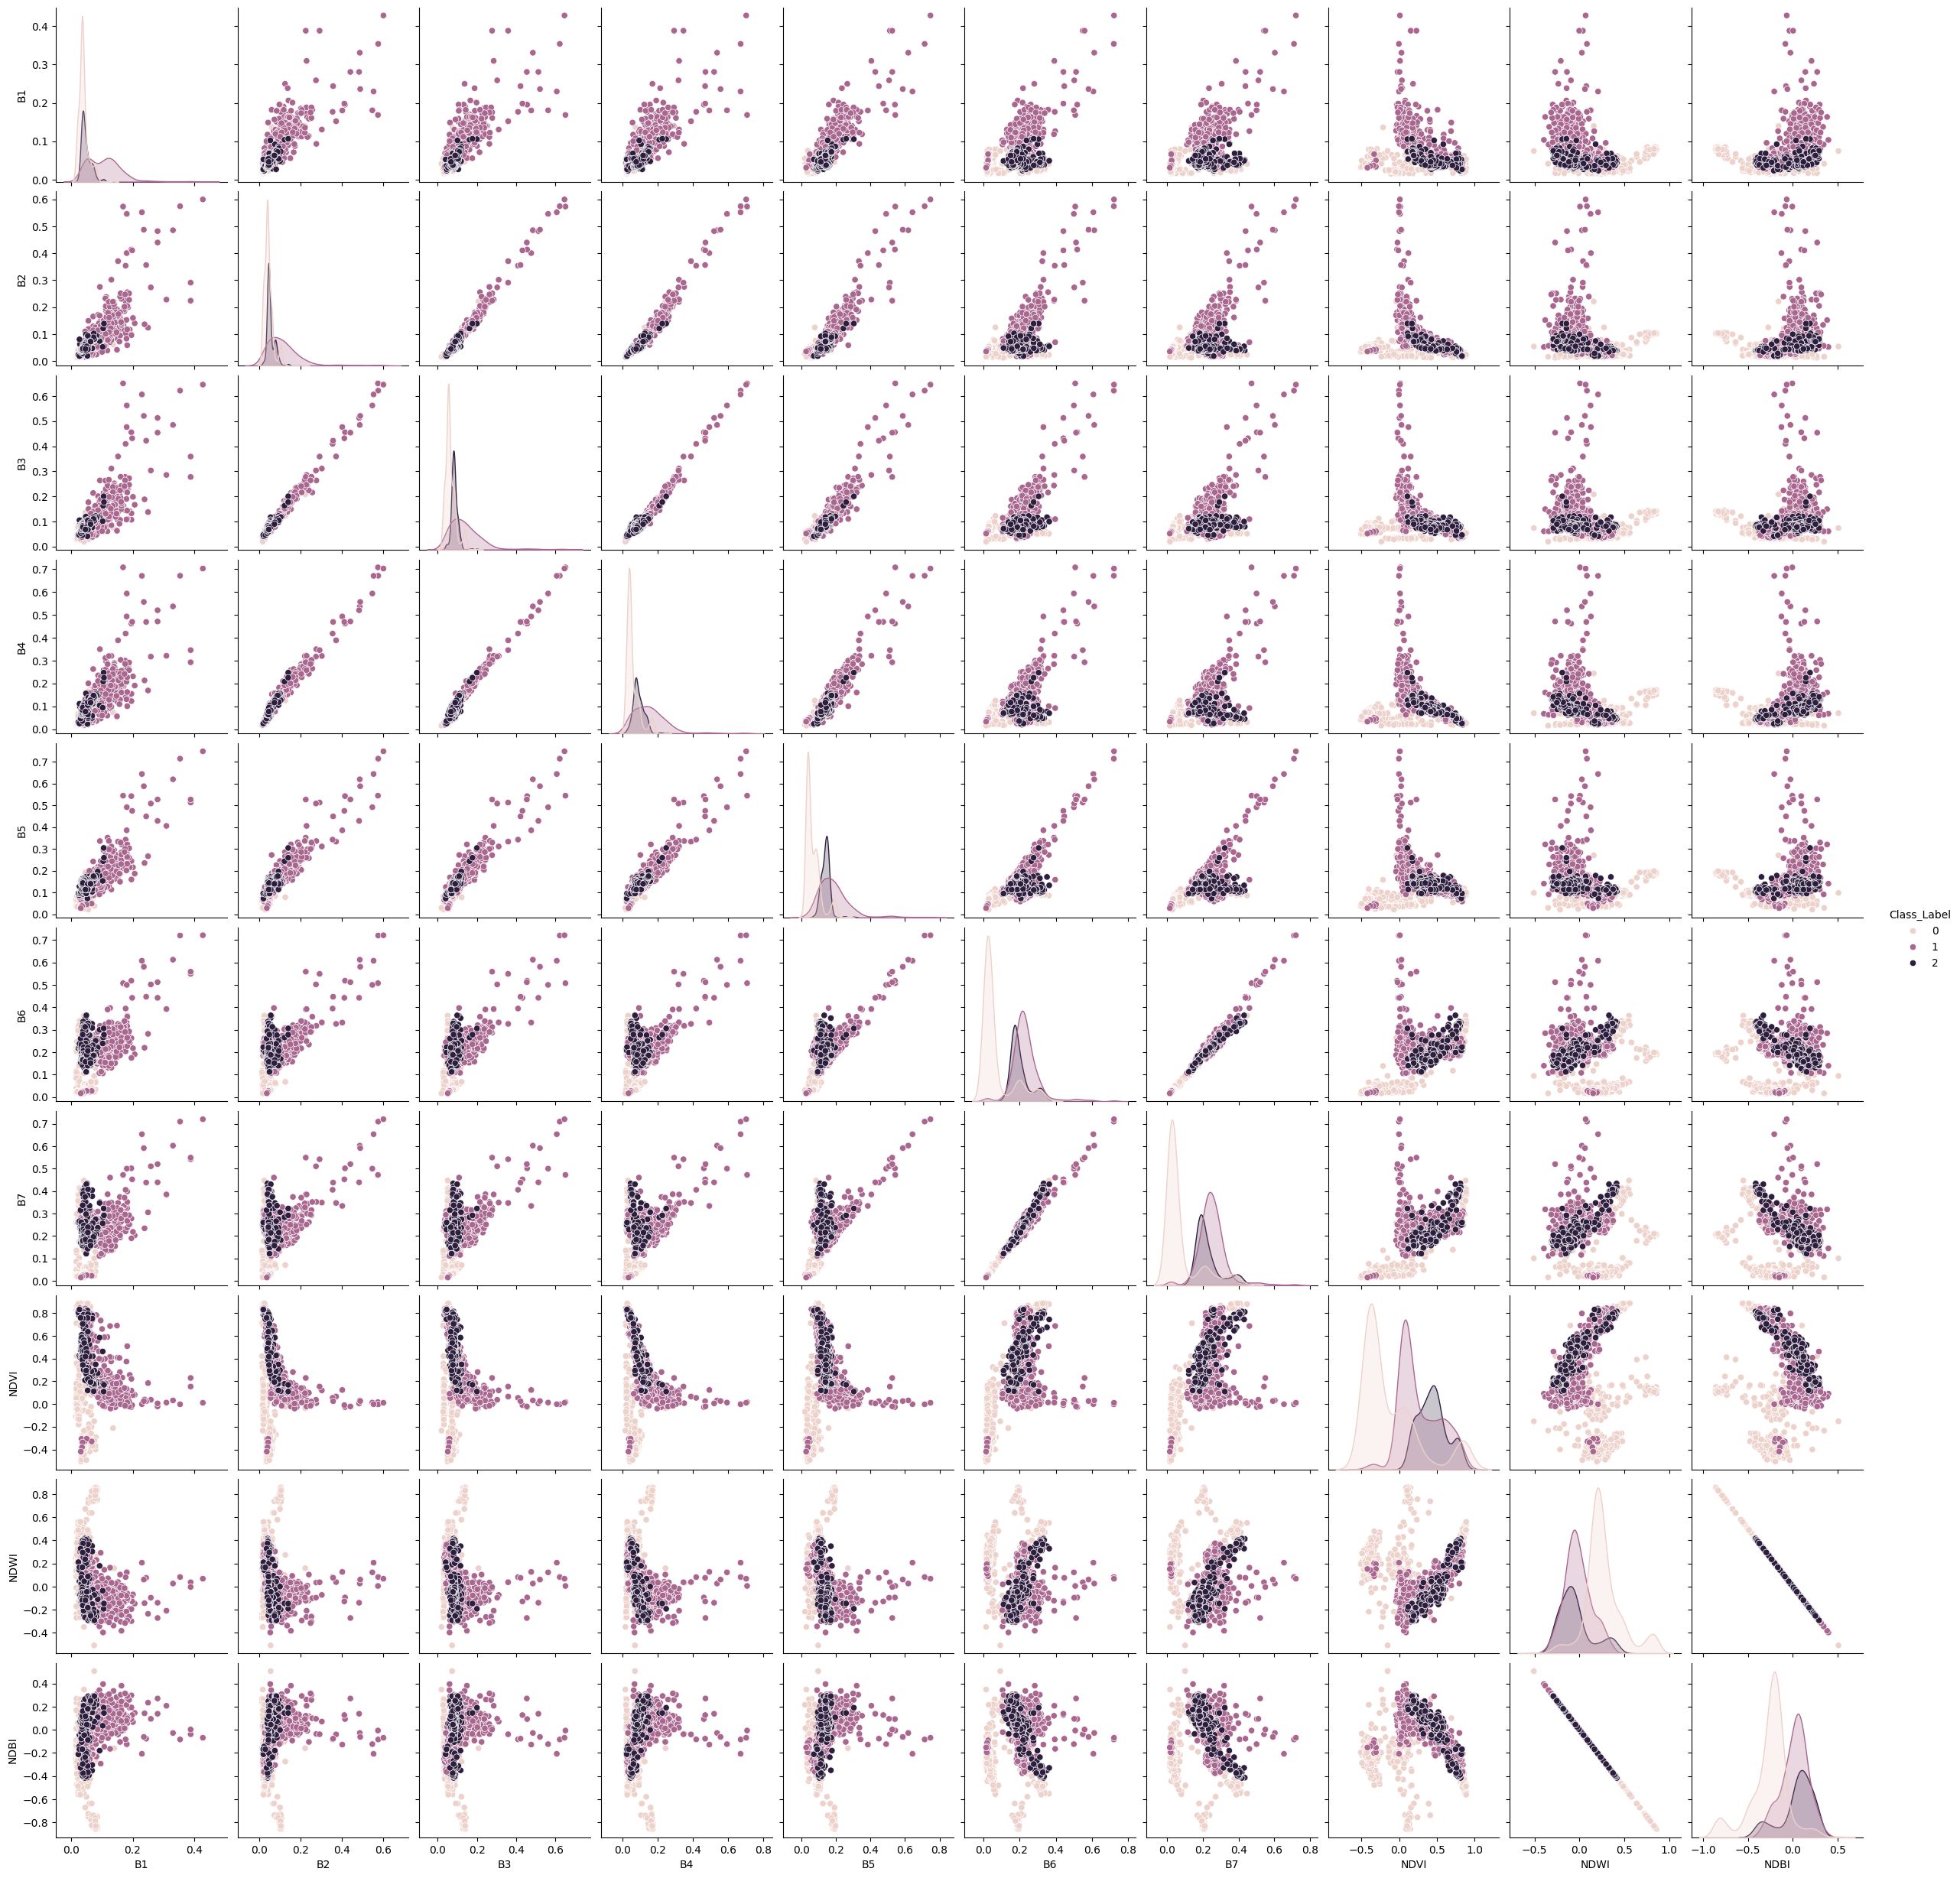
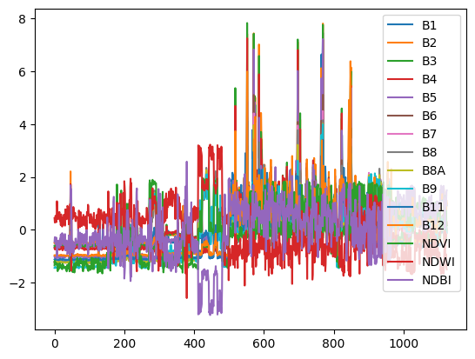
DATA AND DATA ANALYSIS
Table. 2. Outliers
Data | Outliers
B1 | 14
B2 | 20
B3 | 19
B4 | 16
B5 | 17
B6 | 12
B7 | 7
B8 | 8
B8A | 4
B9 | 3
B11 | 5
B12 | 12
NDVI | 0
NDWI | 20
NDBI | 20
Latitude | 0
Longitude | 0
Fig. 6. Visualisation of Zscore
Fig. 5. pairplot visualisation
11
Original data with Outliers Visualizations

Slide 12
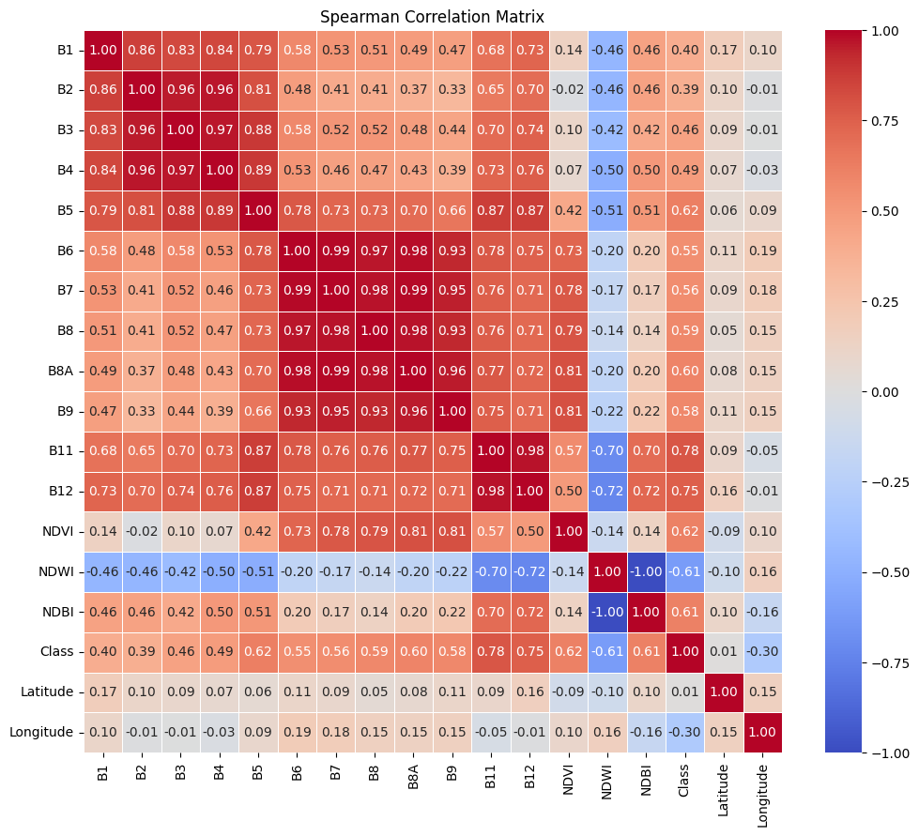
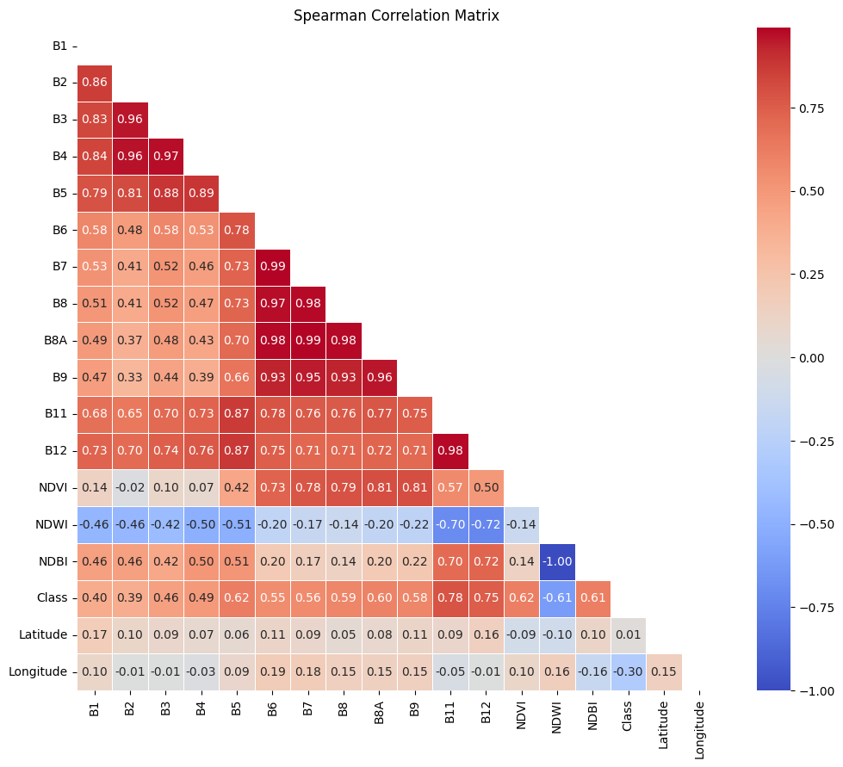
DATA AND DATA ANALYSIS
Table. 3. Correlation
Data | Correlation
B1 | 0.396474
B2 | 0.385987
B3 | 0.456653
B4 | 0.485706
B5 | 0.621036
B6 | 0.552642
B7 | 0.556062
B8 | 0.585656
B8A | 0.595818
B9 | 0.581494
B11 | 0.781669
B12 | 0.7514
NDVI | 0.616515
NDWI | -0.6126
NDBI | 0.612607
Latitude | 0.012106
Longitude | -0.29816
Fig. 7. Correlation among the data
12
Original data with Outliers Correlation

Slide 13
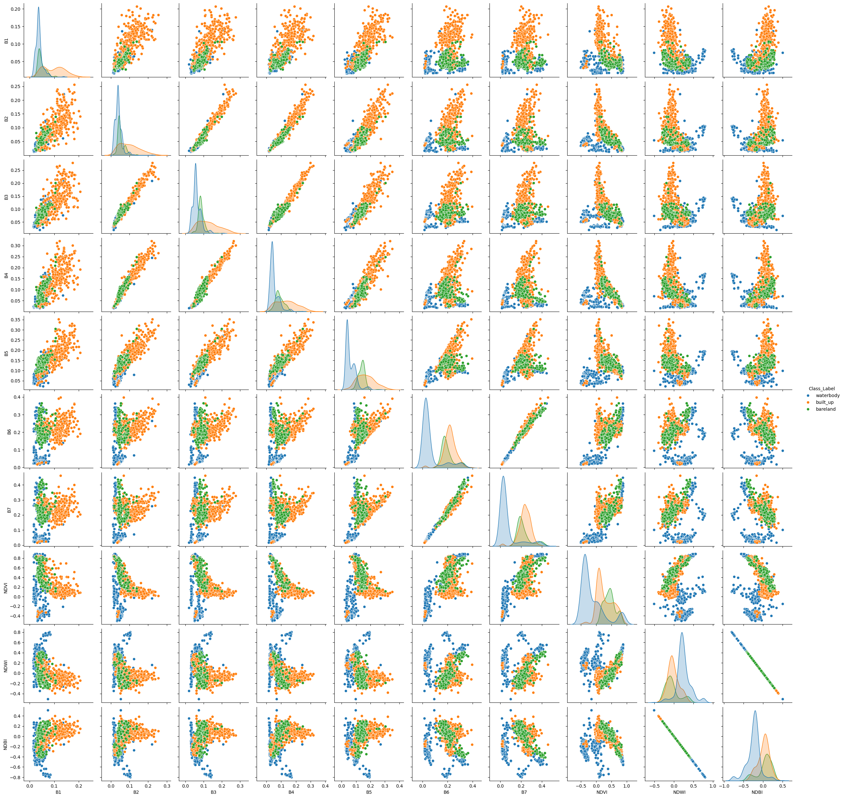
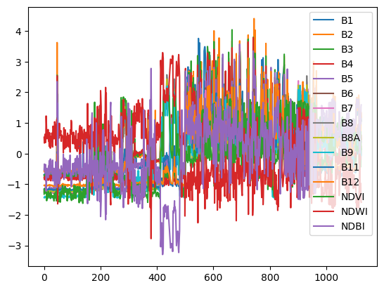
DATA AND DATA ANALYSIS
Fig. 8. Visualization after Outlier removal
13
After Outlier Removal Visualisations

Slide 14
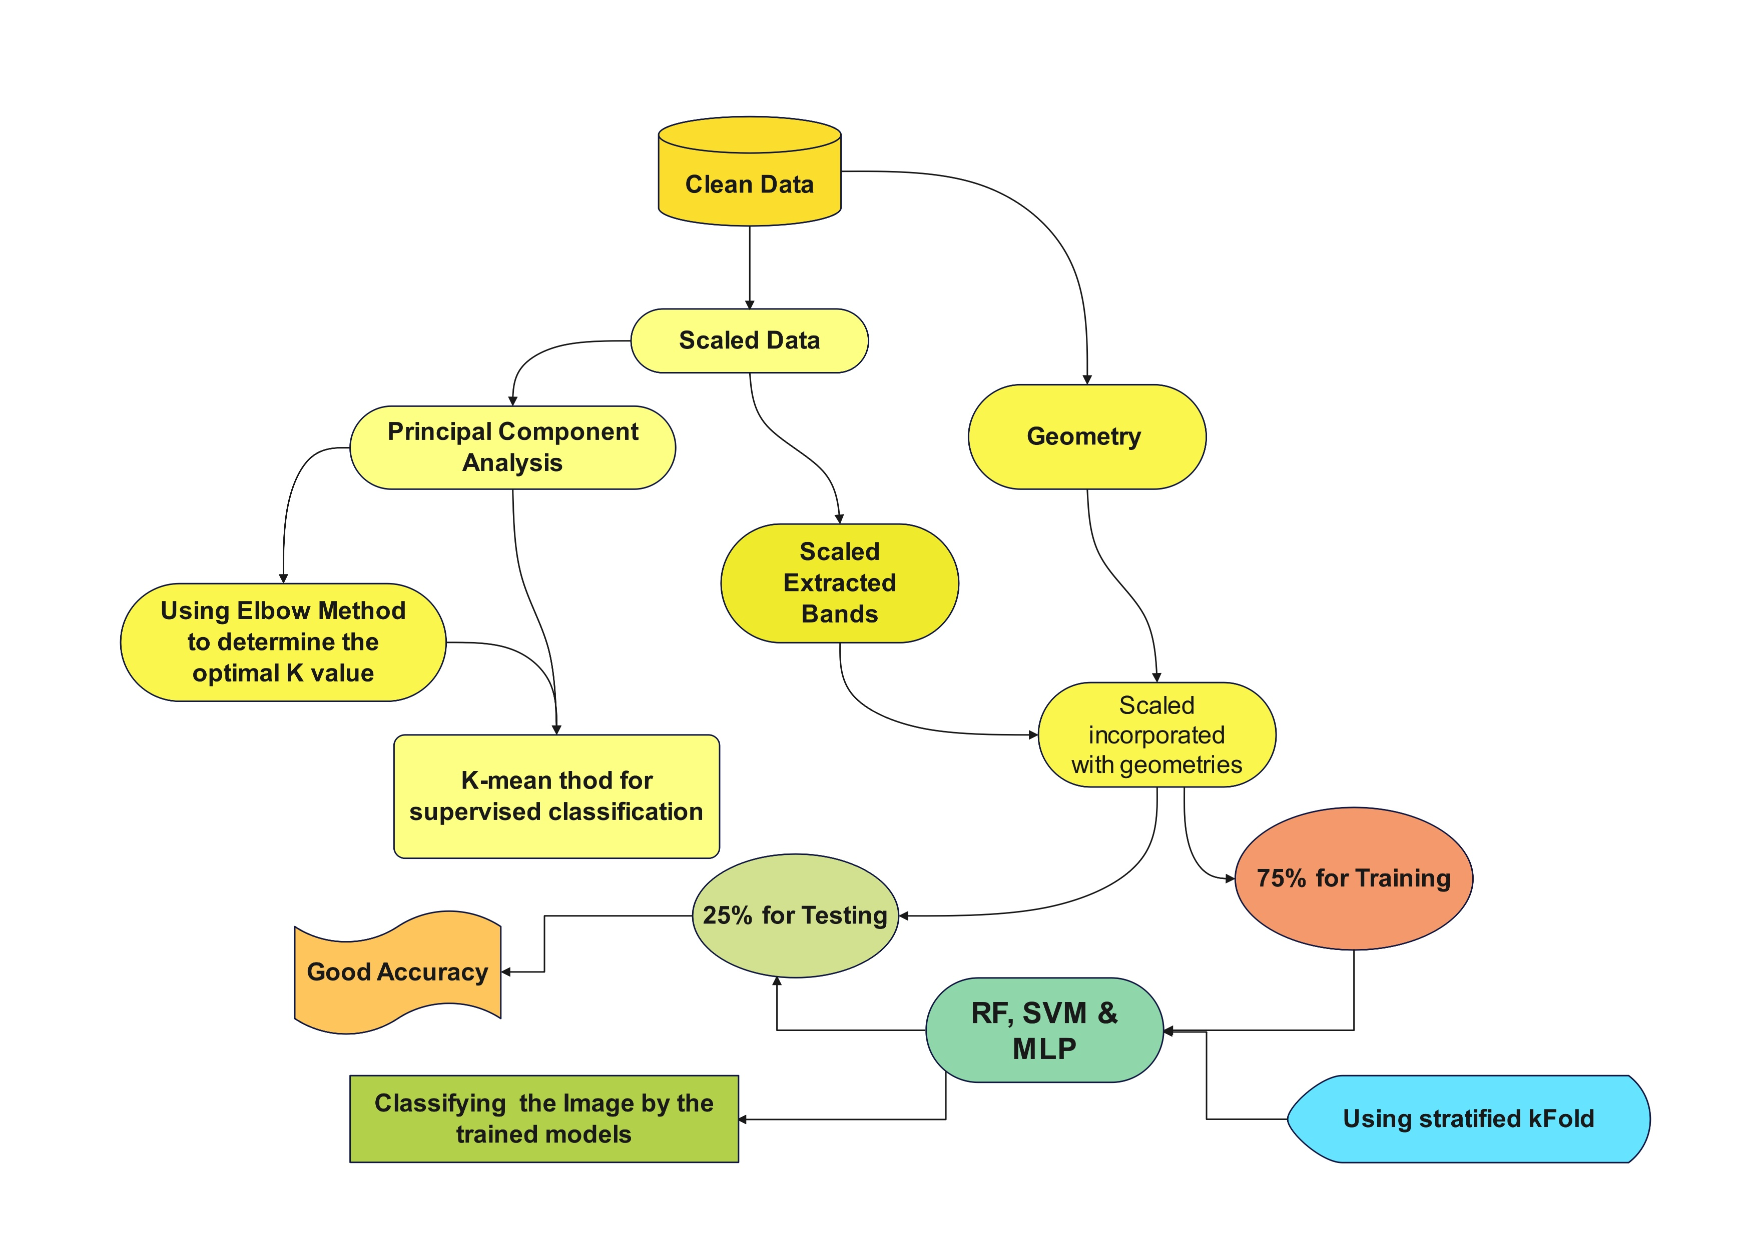
METHODS USED
Fig. 9. Flowchart of the Methods
14

Slide 15
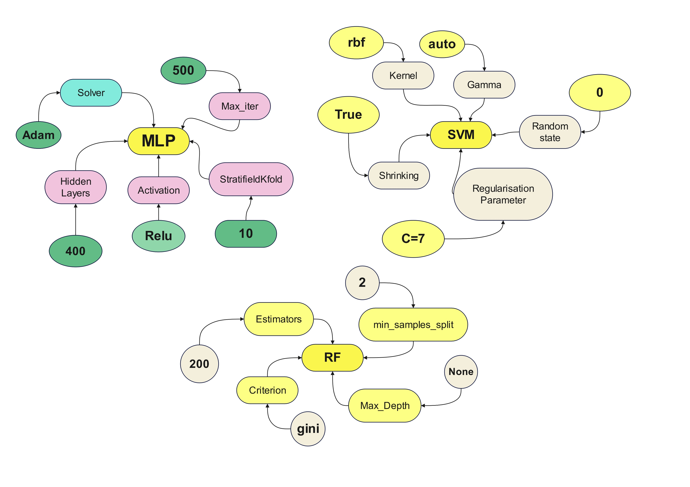
METHODS USED
Fig. 11. Building SVM
Fig. 10. Building MLP
Fig. 12. Building RF
15

Slide 16
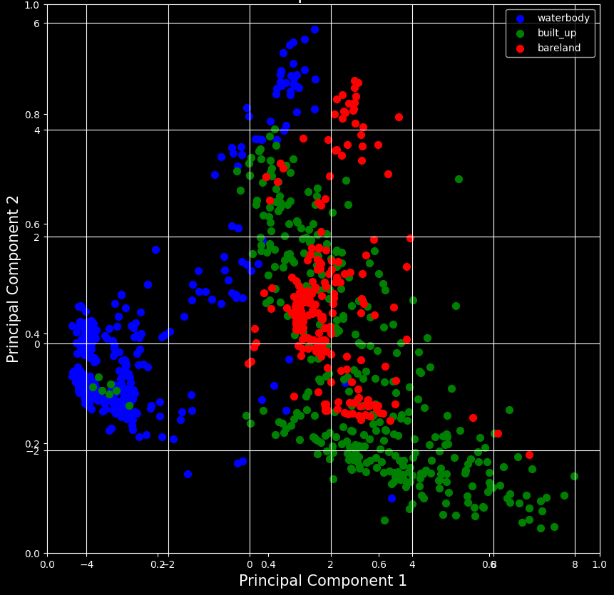
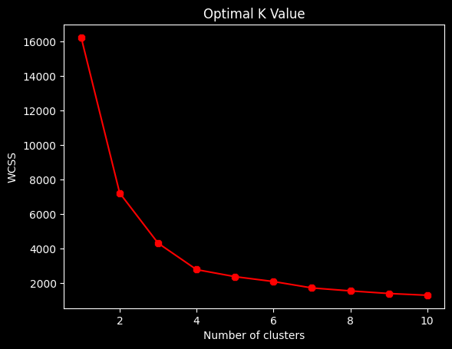
RESULTS AND DISCUSSION
Fig. 14. Building SVM
Fig. 13. Building PCA
16
Unsupervised Classification

Slide 17
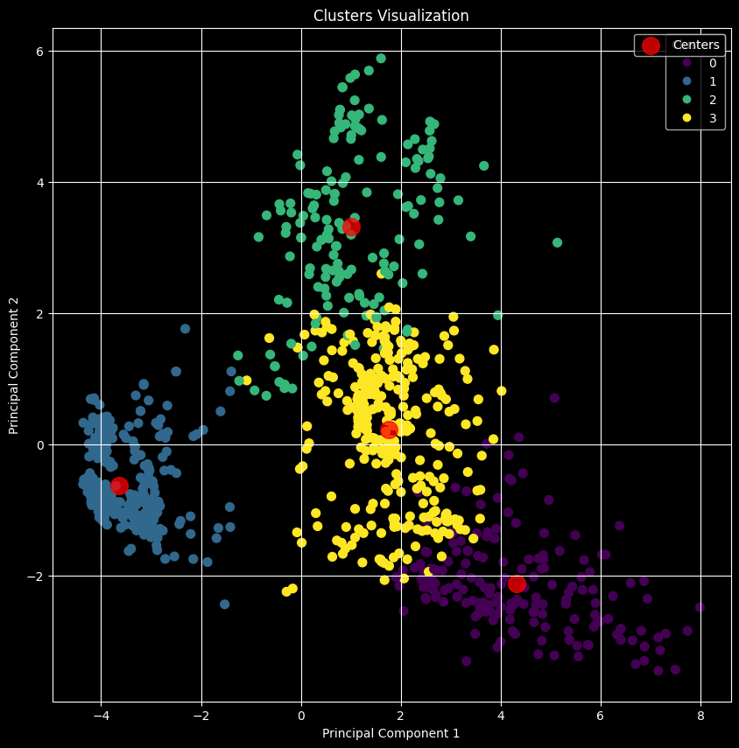
RESULTS AND DISCUSSION
Table. 4. Explained variance
Component | Explained Variance
Principal Component 1 | 62.17%
Principal Component 2 | 21.03%
Principal Component 3 | 11.26%
Contributing a total cumulative explained variance
Of 94.46638%
Fig. 15. K Means Clustering
17
Unsupervised Classification

Slide 18
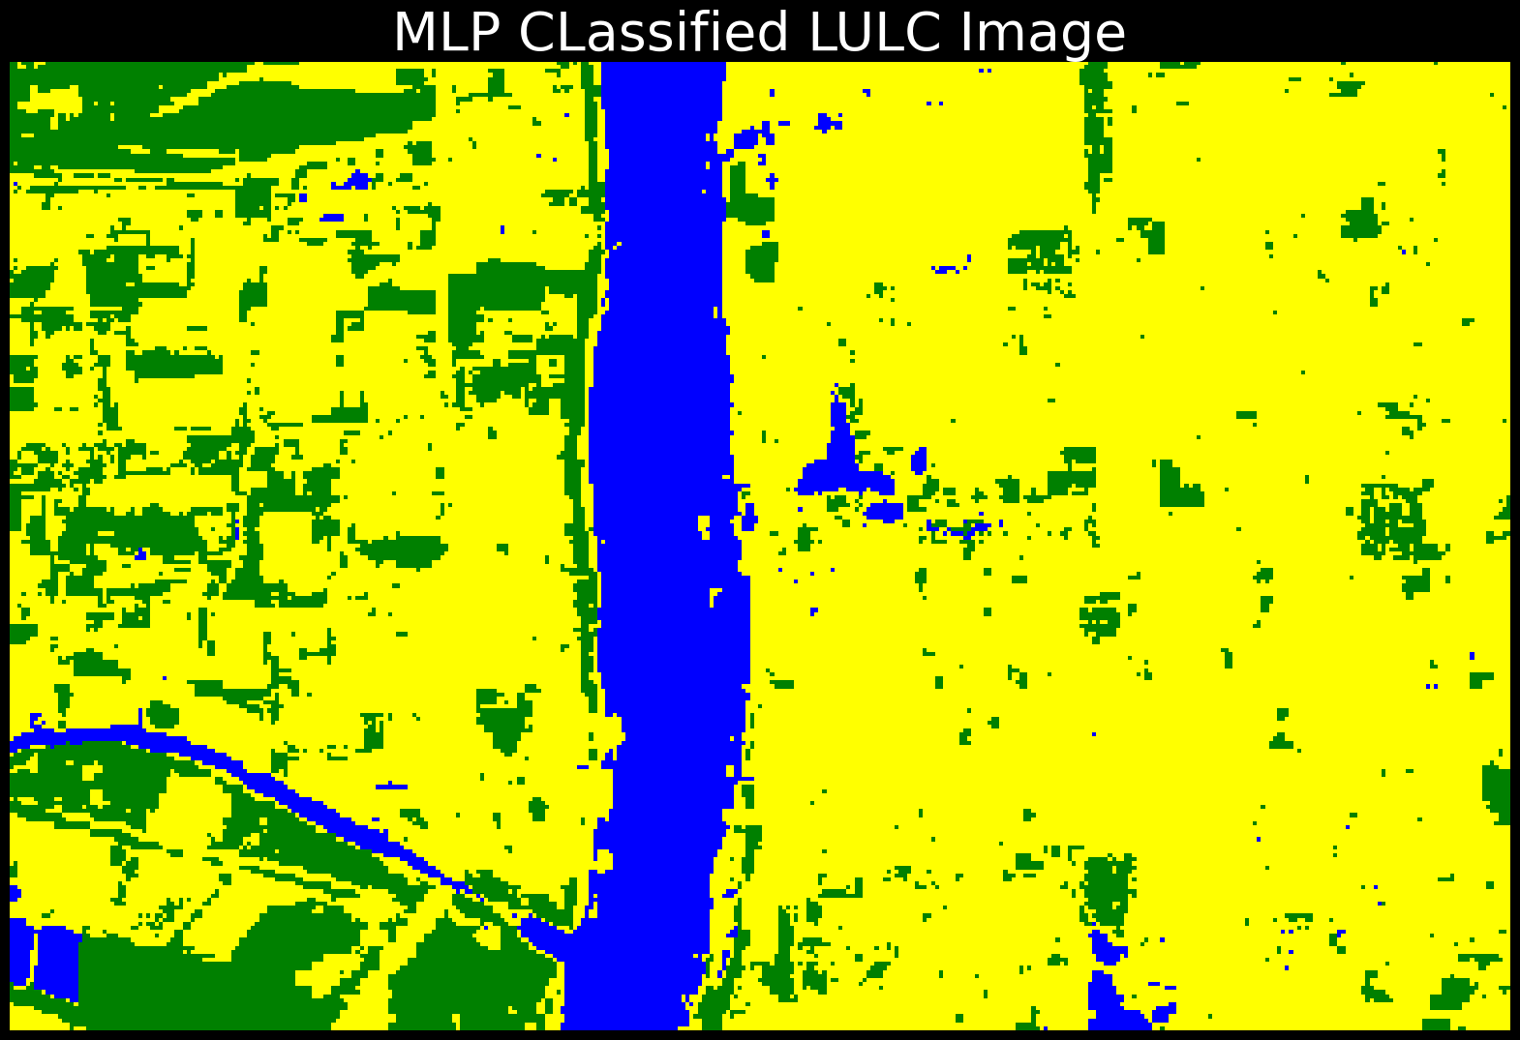
RESULTS AND DISCUSSION
Table. 5. Accuracy evaluation
Training Accuracy |  |  |  | 92.79%
Testing Accuracy |  |  |  | 89.96%
 | precision | recall | f1-score | support
Bareland | 0.78 | 0.83 | 0.81 | 60
Built-Up | 0.87 | 0.85 | 0.86 | 98
Waterbody | 0.96 | 0.95 | 0.96 | 111
accuracy |  |  | 0.89 | 269
Bare land
Waterbody
Fig. 16. MLP classified Image
Built-up
18
Supervised Classification

Slide 19
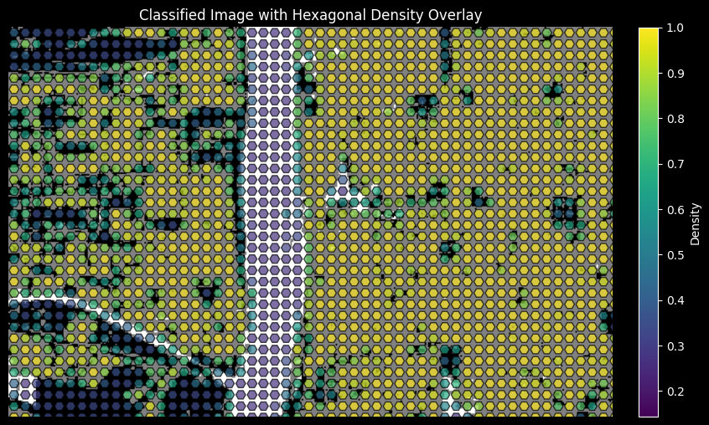
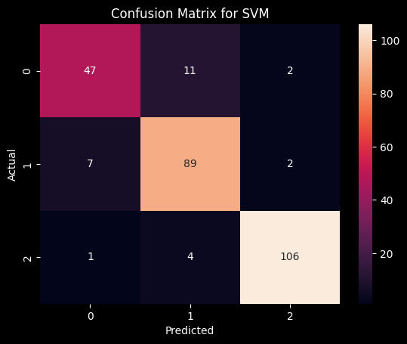
RESULTS AND DISCUSSION
Fig. 18. MLP Confusion Matrix
Fig. 17. MLP Density Variation Map
19
Supervised Classification

Slide 20
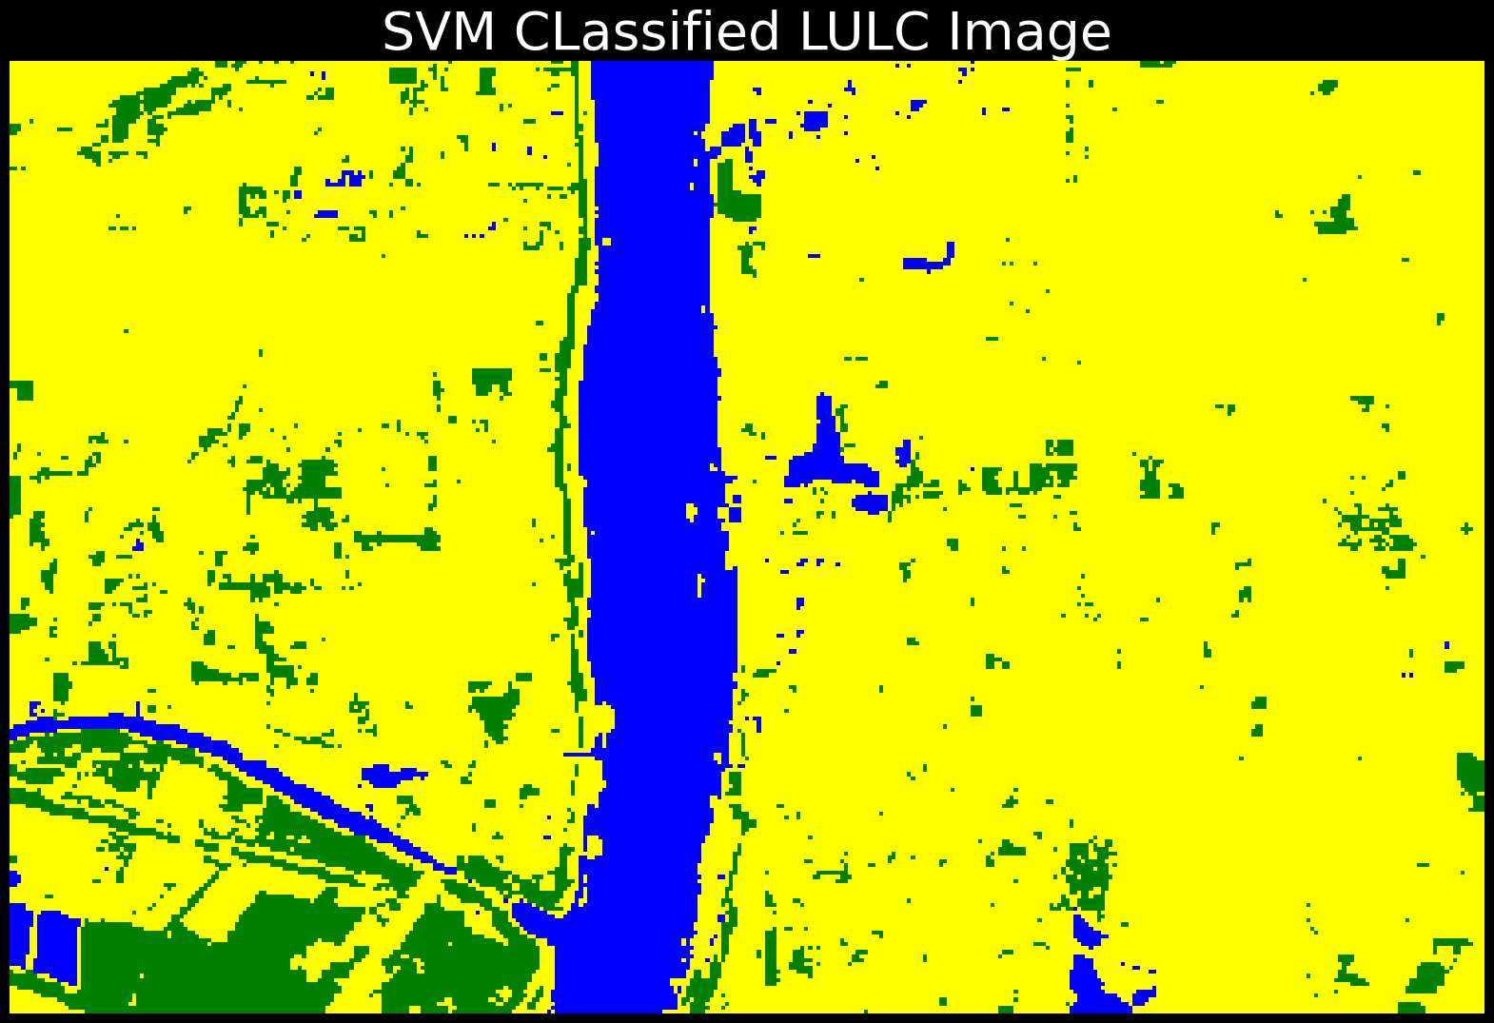
RESULTS AND DISCUSSION
Table. 6. Accuracy evaluation
Training Accuracy |  |  |  | 86.8364%
Testing Accuracy |  |  |  | 85.5019%
 | precision | recall | f1-score | support
Bareland | 0.86 | 0.60 | 0.71 | 60
Built-Up | 0.76 | 0.92 | 0.83 | 98
Waterbody | 0.96 | 0.94 | 0.95 | 111
accuracy |  |  | 0.86 | 269
Bare land
Waterbody
Fig. 19. SVM Confusion Matrix
Built-up
20
Supervised Classification

Slide 21
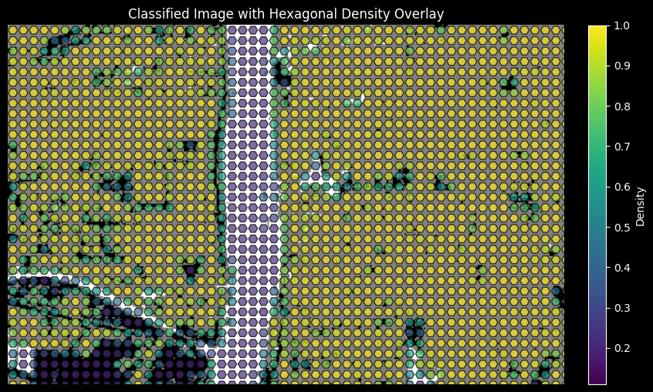
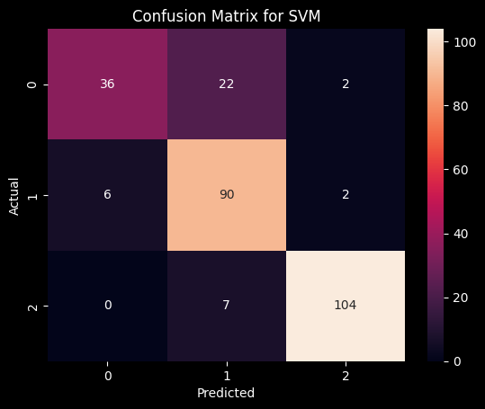
RESULTS AND DISCUSSION
Fig. 20. SVM Confusion Matrix
Fig. 19. SVM density variation
21
Supervised Classification

Slide 22
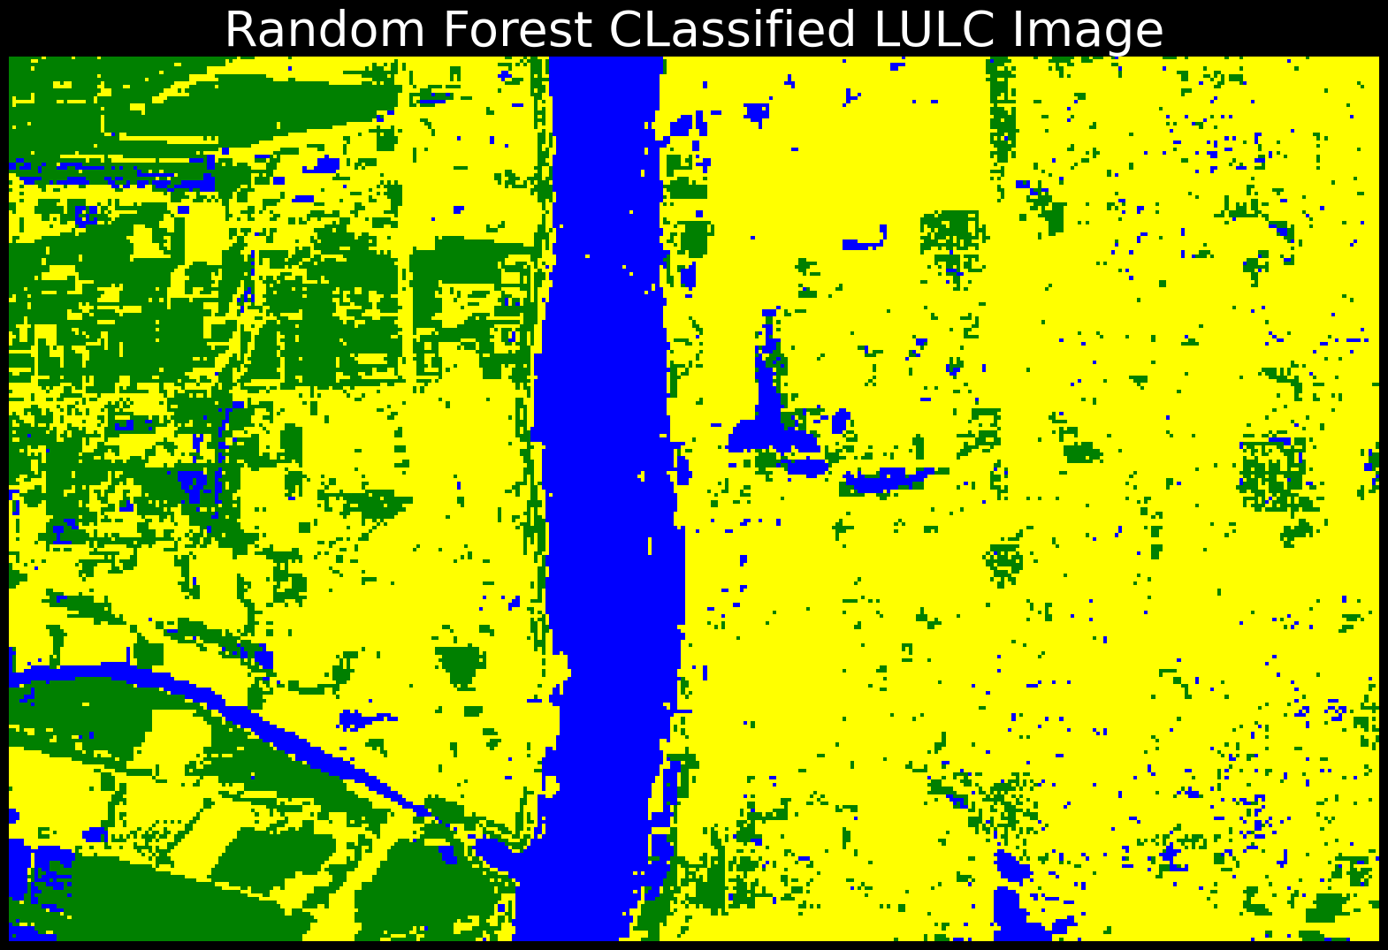
RESULTS AND DISCUSSION
Table. 7. Accuracy evaluation
Training Accuracy |  |  |  | 92.667%
Testing Accuracy |  |  |  | 92.9368%
 | precision | recall | f1-score | support
Bareland | 0.90 | 0.87 | 0.88 | 60
Built-Up | 0.91 | 0.91 | 0.91 | 98
Waterbody | 0.96 | 0.98 | 0.97 | 111
accuracy |  |  | 0.93 | 269
Bare land
Waterbody
Fig. 20. Random Forest Classified Image
Built-up
22
Supervised Classification

Slide 23
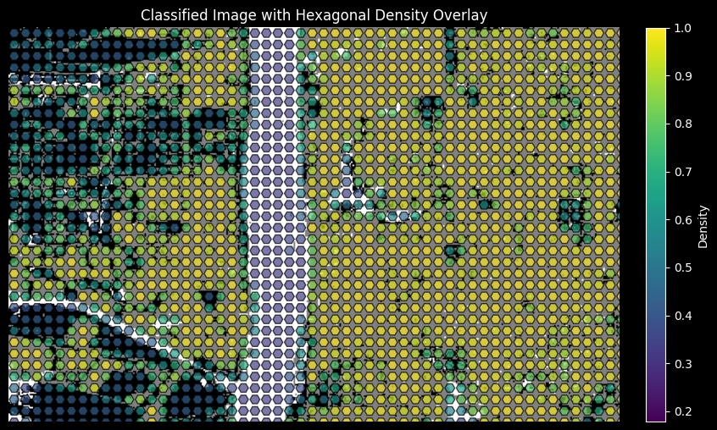
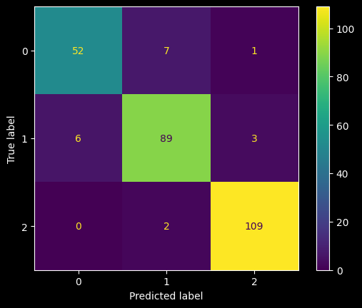
RESULTS AND DISCUSSION
Fig. 22. SVM Confusion Matrix
Fig. 21. RF Density Variation
23
Supervised Classification

Slide 24
CONCLUSIONS AND RECOMMENDATIONS
In a nutshell, these machine learning models have proved accuracy, efficiency and also precision by accurately classifying satellite image which is not sharp enough.
I recommend these machine learning models in other environmental monitoring projective and also precision agricultures farming for precise classifications.
24
Supervised Classification

